Slide 1
Classification Machine Learning
Data Science at Zindua School | By Chris Aloo

Slide 2
Classification Intuition

Slide 3

















Slide 4












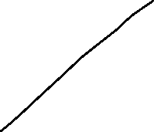

Slide 5










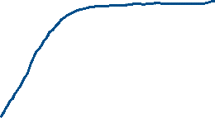








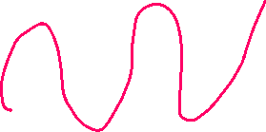



Slide 6






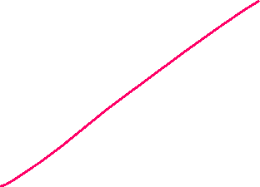








Slide 7



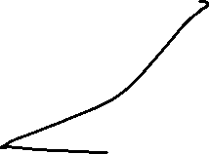
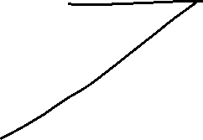


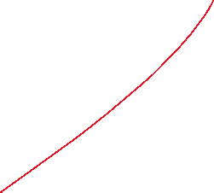


Slide 8
 | X1 | X2 | X3 | X3 | Y | Binary
 | Age | Hours Worked in a month | Position | Experience | Churn/Attrition | Encoded
1 | 30 | 17 | Associate | 32 | Yes | 1
2 | 91 | 70 | Junior | 45 | Yes | 1
3 | 69 | 15 | Senior | 12 | No | 0
4 | 94 | 8 | Manager | 26 | No | 0
5 | 64 | 28 | Senior Manager | 18 | Yes | 1
 | X1 | X2 | X3 | X3 | Y
 | Number of Local Cals | Hours Called | Gender | Satisfaction Re | Multiclass
1 | 30 | 17 | Male | 32 | High
2 | 91 | 70 | Female | 45 | Medium
3 | 69 | 15 | Other | 12 | Low
4 | 94 | 8 | Male | 26 | High
5 | 64 | 28 | Female | 18 | Low

Slide 9
K-Nearest Neighbors

Slide 10
Idea:
Similar examples have similar label.
Classify new examples like similar training examples.
Algorithm:
Given some new example x for which we need to predict its class y
Find most similar training examples
Classify x “like” these most similar examples
Questions:
How to determine similarity?
How many similar training examples to consider?
How to resolve inconsistencies among the training examples?

Slide 11
1-Nearest Neighbor
One of the simplest of all machine learning classifiers
Simple idea: label a new point the same as the closest known point
Label it red.

Slide 12
A type of instance-based learning
Also known as “memory-based” learning
Forms a Voronoi tessellation of the instance space

Slide 13
Distance Metrics
Different metrics can change the decision surface
Standard Euclidean distance metric:
Two-dimensional: Dist(a,b) = sqrt((a₁ – b₁)² + (a₂ – b₂)²)
Multivariate: Dist(a,b) = sqrt(∑ (a_{i} – b_{i})²)
Dist(a,b) =(a₁ – b₁)² + (a₂ – b₂)²
Dist(a,b) =(a₁ – b₁)² + (3a₂ – 3b₂)²
Adapted from “Instance-Based Learning”
lecture slides by Andrew Moore, CMU.

Slide 14
A distance metric
Euclidean
When different units are used for each dimension
→ normalize each dimension by standard deviation
For discrete data, can use hamming distance
→ D(x1,x2) =number of features on which x1 and x2 differ
Others (e.g., normal, cosine)
How many nearby neighbors to look at?
One
How to fit with the local points?
Just predict the same output as the nearest neighbor.

Slide 15
Generalizes 1-NN to smooth away noise in the labels
A new point is now assigned the most frequent label of its k nearest neighbors
Label it red, when k = 3
Label it blue, when k = 7

Slide 18
Logistic Regression

Slide 21
Decision Trees

Slide 24
Random Forest

Slide 27
Support Vector Machines

Slide 30
Boosted Models

Slide 32
End…

